Slide 1

Work – Life
Balance
Weighing the importance of work life and personal life.

Slide 2










Slide 3

Introduction and Motivation

Slide 4

Introduction and Motivation
Now we are going to enter the professional life and each one of us is facing the dilemma of whether we should enter government sector or private sector. We started wondering that in whichever sector we go, how can we get more out of our professional and personal life so that we can obtain by having perfect balance between them.
Work-life balance teaches us that we all have the right to be ambitious in pursuing our career goals, but not at the cost of losing important emotional and personal ties with people with whom you are going to share relationships with throughout your life.

Slide 5

OBJECTIVE

Slide 6

OBJECTIVE
To investigate the Work- Life balance of employees in the private and government sectors.
To determine the factors impacting the Work- Life balance of the employees.
To analyse how personal life affects the professional life.

Slide 7

Data Source And Collection

Slide 8
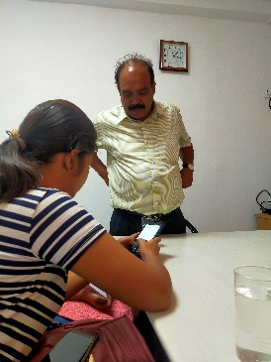
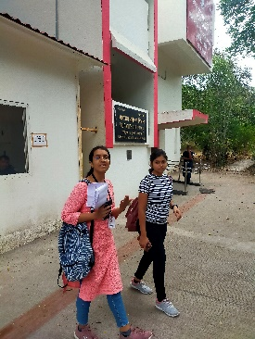
Data Source And Collection
Type of data we worked on, is Primary Data.
We separately produced questionnaires for government organisations and commercial organisations.
Further, we gathered data from three separate regions of Pune i.e. Shivajinagar, Yervada and Camp.
50 responses from government offices, and 50 responses from private businesses, totalling 100 responses from employees in each sector from each area.
Some of the questions are-
Commuting time
Are you satisfied the income according to your work load?
Do you get time to destress yourself?
How often do you think or worry about work(when you are not actually at work)?

Slide 9

Exploratory Data Analysis

Slide 10
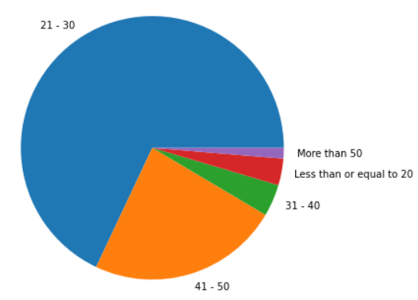
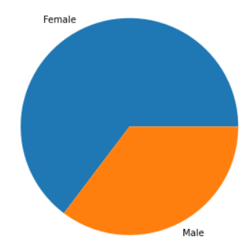
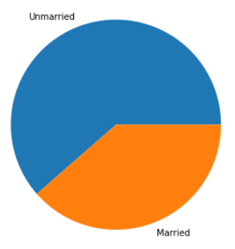
Exploratory Data Analysis
Age group
Less than or equal to 20 - 3.27 %
21 – 30 - 68.0 %
31 – 40 - 3.9 %
41 – 50 - 23.5 %
More than 50 - 1.33 %
Marital Status
Gender
Female – 64.7%
Unmarried – 61.4%
Male – 35.3%
Married– 38.6%

Slide 11

Statistical Analysis

Slide 12
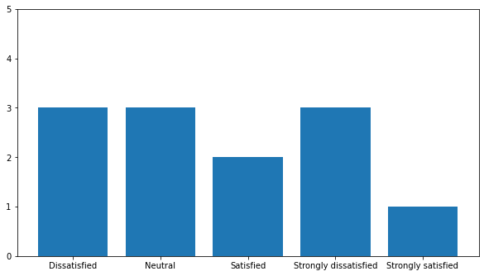
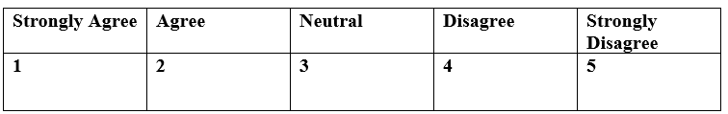
Statistical Analysis
Using Relative Importance Index , we obtained Income as the most relevant question among employees ,followed by remaining questions.
Therefore, taking income into consideration with the application of Likert scale, we can observe that income is positively related to Work life balance.
Have Work Life Balance
3
3
3
2
1
Dissatisfied
Neutral
Satisfied
Strongly Dissatisfied
Strongly satisfied
Satisfied with Income?
After considering various variables into consideration, overall result of Likert Scale says that Government employees Agree to the statement of having work life balance while Private people are Neutral about work –life balance.

Slide 13
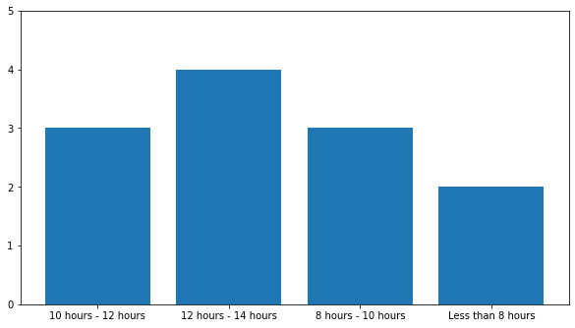
We discovered that if the number of working hours is increased, employees find it difficult to manage their work-life balance.
Being married or unmarried does not affect a person's Work-Life Balance.
As employees gain work experience, they become better able to manage their professional and personal lives.
Males have a better Work-Life Balance than females.
Work-life balance is negatively related to the employees thinking about their work after working hours.
Have Work Life Balance
4
3
3
2
10 – 12 hours
12 – 14 Hours
8 – 10 Hours
Less than 8 hours

Slide 14

Limitations, Possible Solutions and Scope

Slide 15
Limitations, Possible Solutions and Scope
It’s not necessary that only these factors are responsible for Work- Life Balance , since this project is a small scale study ,that’s why we have considered only possible factors.
As per our analysis, various factors can be taken into consideration both by the employer and employee so that both of them can get the maximum outputs.
The employee will be able to manage his personal life and work life getting a perfect balance.
Also, this can help increase the productivity of employees which indirectly will profit the employer.
Taking steps like, not worrying about work during non-working hours , sparing time to destress yourself from the work, performing body exercises, etc can be a possible solution. For this organisations can incorporate policies which help to distress and plan activities which involve physical exercise.
This project has the potential to be scaled up to cover a wide range of areas.

Slide 16

Thankyou…

